Slide 1

React Applications with React, React-Router and Flux
Notes:
React application architecture with react router and flux
Some of my code is based on a pluralsight course by Cory House. (especially the cookiesAPI)

Slide 2
What is React?
MVC
V
VC
Notes:
Let’s start by defining react.
React is a JavaScript library for creating user interfaces. It was and is developed by Facebook and Instagram.
They built react to solve one problem: building large applications with data that changes over time.
MVC
*** click
Is React the V in MVC?
*** click
Many people choose to think of React as the V in MVC.
*** click
- It can be the V and the C.
- A controller view can be like the controller in ASP.net MVC.
It can handle the data concerns while having dumb child components.
One of the reasons React is so fast is because React maintains a “virtual dom” which is compared to the browser’s DOM to determine what components need to be re-rendered, if anything.
React, by itself, it’s not a complete solution. So, in this presentation, I’m going to be showing how React can be used with other frameworks and libraries to create a simple web app.
URL
https://facebook.github.io/react/docs/thinking-in-react.html

Slide 3
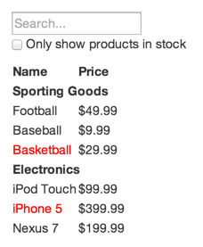
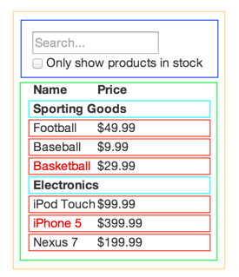
Thinking in React
Notes:
Thinking in React.
What does a react component look like conceptually?
Start by mocking your UI. Just draw what it should look like.
*** click
Then draw boxes around every component and subcomponent and give them names.
*** click
Easy?
Not so fast you say, it doesn’t seem that easy. How do you decide if something should be its own component? Think of the single responsibility principle. If a section of your UI is doing just 1 thing, make it its own component.

Slide 4
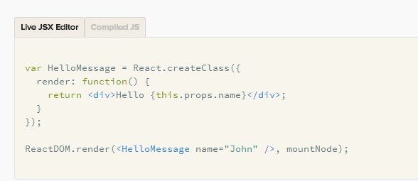
Structure of a React Component
Notes:
Here’s what a react component looks like in code. You’ll notice what looks like HTML markup INSIDE javascript code.
In case you haven’t seen this before, this is JSX. You don’t have to use JSX with React, but it’s a lot nicer to work with than trying to go strict javascript.
You can see we’re using React.createClass and creating a render method. This method contains markup and other child components.
The call to render at the bottom of the example is not usually found in the same file as the component.

Slide 5
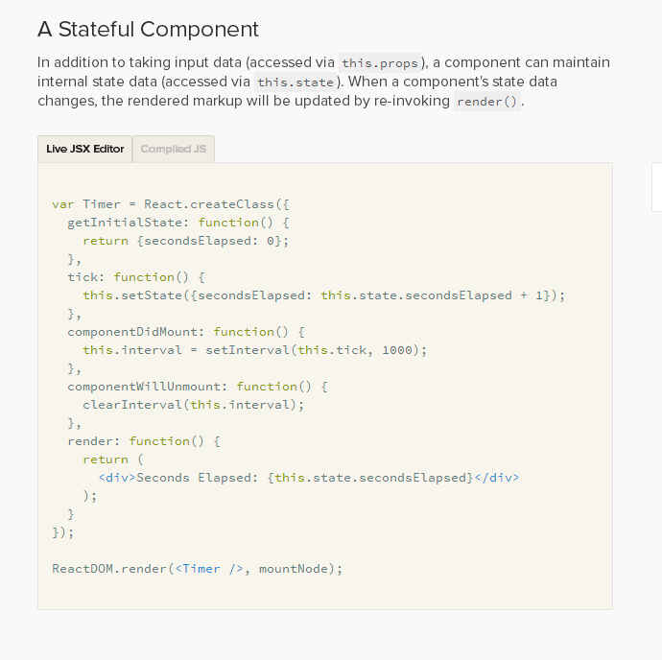
Structure of a stateful React Component
Notes:
This component updates its own state. Components have two main collections of data. State and Props. Props are passed in by parent components. Usually, the parent has the state, and passes it down to the child as a Prop. Props are immutable.

Slide 6
Code example
Notes:
******* Git Checkout v1
Look at cookiesPage react component.
Look at createCookieRow function. You need a key attribute on repeated elements to help React keep track of them.
This is a single react component right now but you can probably see some room for improvement. The page has a heading, then a table, then some table rows. Later you’ll see how we extract the table into its own component.
Notice in our react component, we're using the older (es5) syntax. There is a new way to create a react component using ES6 which uses classes and extending the react component class. I'm not using that here just for simplicity. I have implemented a gulp task to transpile using babelify and rewriting all the js to use es6 syntax is something I’m planning on doing.
Lets take a moment to look at the dev environment I’m using since it’s pretty darn cool.

Slide 7
Gulp
And sublime text
Notes:
Look at v1 gulp file.
Gulp and its dependencies are all installed with npm.
It does some cool things for us that make developing a web app a ton easier.
var gulp = require('gulp');
var connect = require('gulp-connect'); // Runs a local dev server, supports live reload
var open = require('gulp-open'); // Open a URL in a web browser
var browserify = require('browserify'); // Bundles JS
var reactify = require('reactify'); // Transforms React JSX to JS
var source = require('vinyl-source-stream'); // use conventional text streams with Gulp
var concat = require('gulp-concat'); // Concatenates files
I’m also using sublimetext with some super helpful plugins: Emmet for html code completion. JSX Linting and a vim plugin.
*****Demo live reload and using emmet to add an div>ul>li to the cookiesPage

Slide 8
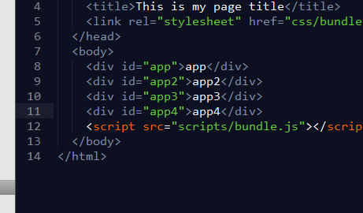
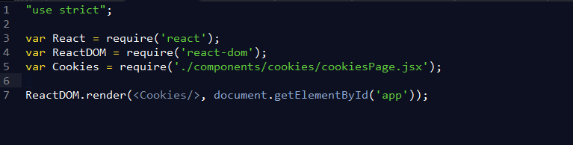
How is the react component invoked?
Notes:
On a side note – some of you may be wonder, How is a react component invoked? Is it an element in an HTML file?
You don’t put it in an html file directly. You use javascript to tell React to render a component on top of an element you identify by ID.
*******Here’s an index.html file
*******And here’s the javascript that loads the react component.
You can see it's pretty straightforward to create a react component, and wire it up to a dom element.

Slide 9
Data access and components
Notes:
I've created a mock web api just so we can demo how React components might interact with an API.
Since we have this mock api, we can interact with it by creating a component that displays the data.
In order to separate data access from your components. You can create a "Controller View" that handles data concerns.
A controller view is simply a react component that has child components. The controller controls data flows for all child components. It sets the props on the child components. It will also interact with the flux stores which we'll talk about later.
Look real quick at cookiesPage.jsx, see how it consumes the cookiesApi.
**** Git checkout v2
Look at the cookiesPage. It would be considered a controller view now because it delegates the markdown to child components and passes the state to them.
Look at cookiesList. Now you can see how the cookies object that was passed in, is referenced via this.props.cookies.

Slide 10
Client Side Routing
Notes:
***** git checkout v3
***** run gulp
**** Click around
Take a moment to notice that I’m dynamically loading react components without a full page reload.
Since react is narrowly focused on being a view engine, it has no opinion on how routing should work.
React router is used at Facebook. React router is client side routing. Because of this, moving between views doesn't require a get from the server. This makes the application much more responsive.
**** show the routes.js file and how we’re rendering the route component in app.jsx
Notice that there’s a history attribute on the router – that has to do with faking browser history. Since it’s client side routing, the browser isn’t going to automatically create history as you navigate around the app. React-Router has several different ways of handling history. And depending on your web server, it can be pretty easy to get rid of the # in the URL. Because I’m using gulp-connect as my web server, it’s not super easy to get rid of the # so that’s why you’re seeing it everywhere.

Slide 11
More State vs props
Notes:
State vs Props
Most of the time your component will simply take in props and render itself. If you want to respond to user input, or other things like a timer, response from a server, etc - you need to use state.
Facebook says to "try to keep as many of your components as possible stateless. "
State in the controller view is passed down as props to the dumb components.

Slide 12
Adding new cookies
Using a form
Notes:
When working with forms, having a controller view makes a lot of sense. The controller has all the data but very little of the markup.
When you create a form in a React component, if you ever want to interact with it in the future, you need a way to reference it. That's what the ref attribute is for. React will guarantee that the object you refer to by ref is the current version of that object.
If you had this:
<input ref="myInput" />
You could access it directly by calling React.findDOMNode(this.refs.myInput).
Regarding form fields. Without a "change handler", text entered is lost. This is very different from other frameworks where two way binding exists. Here, React is in charge of the form field and by default, disallows any change to the value. Having to explicitly create a change handler may seem like extra unnecessary work but there are benefits to creating your own change handler.
Because we have a controller view (or controller component), state for the form will be handled in there.
Take a look at cookiesForm.jsx
Notice we’re setting a value from a prop – this will be useful later for editing existing cookie records.
Form input fields in react are a bit tricky. If you set a value on an input, React takes control of it. If you don't create a change handler, the user will have no way of entering data.
*****Take out the change handler for Size and see the auto-reload and locked field value.
Look at manageCookies.jsx – the parent component of cookiesForm. This is where the onchange prop is set, via a member function of this component.
Notice that in the setCookieState function, we set this.state.cookie[field] AND then we call this.setState. Simply setting the state property is not good enough to trigger prop updates on child components. When you call setState, then react notifies child components that their props have changed and if needed, re-renders them.
Maybe onChange seems like a lot of work. But there are ways to make this easier. React and flux prefer clarity and scalability over convention and minimizing typing. I FOR ONE, LOVE THIS. Too much convention has a tendency to make code hard to read and understand.
****Look at the cookiesForm again. You can probably see a fair amount of repetition, that’s a sign you should create a new component. In this case, a component for the input box makes a lot of sense.
***** git checkout v4
****Look at cookiesForm. Now we’re using a new react component.
**** Look at textInput.jsx.

Slide 13

Form Hydration
via URL
http://localhost:9005/#/addACookie/Chocolate Chip-Large
Notes:
What if we wanted the form to load existing cookie data so we can edit it. How do we pass the cookie id to this component. One way is to inspect the URL and pull the id out of there. React-router supports both query-string based parameters as well as url path parameters.
****Look at the addACookie.jsx file.
If you look at componentWillMount, react calls this right before a component renders. This is a good place to load data. Here, we’re getting the cookieId from the URL indirectly. We’re leveraging react-router to store part of the URL in the params array inside props.
1, 2, 3

Slide 14
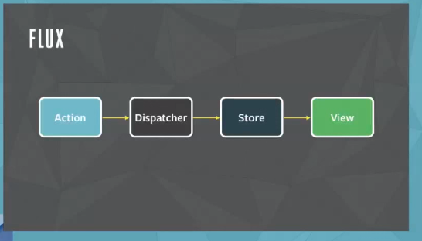
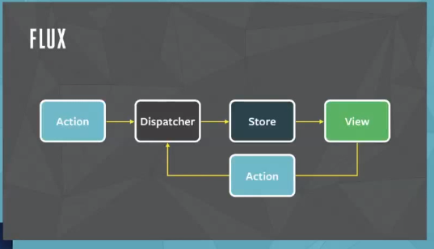
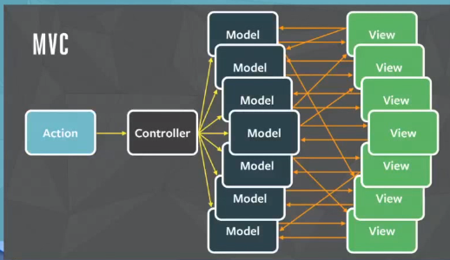
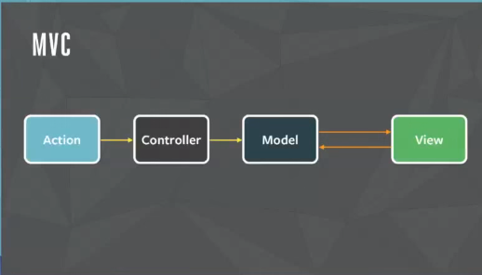
Concerns as your application begins to grow
Notes:
As applications start to get really big, passing data around to where it's needed can start to get complicated. Facebook decided to solve this problem by using uni-directional data flow.
[Steal diagram from this video: https://www.youtube.com/watch?list=PLb0IAmt7-GS188xDYE-u1ShQmFFGbrk0v&time_continue=660&v=nYkdrAPrdcw]
This contrasts with two-way binding you may be used to with frameworks such as Angular, Ember or Knockout.js
With two-way data binding, data from your viewmodel is sent to your view. Changes to the data in the view are reflected in the viewmodel immediately.
With Flux, when the user modifies data in the view, an Action occurs. The dispatcher then notifies any stores that have registered with the dispatcher. The individual stores are in charge of responding to the actions they care about, and ignoring actions they don't, via the function passed to the Dispatcher's register() method. The stores then update themselves via the Action's data and optionally, emit those changes so dependant react components can re-render. Finally, the user sees the updated UI.
This is called uni-directional because the application state is only updated as the result of an action. The view can't directly update the application state directly.
Two way data binding is simpler conceptually and requires less typing but uni-directional data flows have advantages when it comes to testability, code comprehension and predictibility.

Slide 15
More about Flux
Notes:
Flux is the name for a pattern. It is also a framework that implements that pattern.
There are a lot of implementations of this pattern with small differences.
The main gist of Flux is:
- All updates to application state are handled through a central dispatcher. From there, data is dispatched to data stores thoughout your application. To implement this, you need the Flux Dispatcher and a javascript event library.
Why is it called Flux? Because it deals with actions and data changes. Facebook has their own implementation of Flux. It's simply called Flux by Facebook.

Slide 16
Flux implementations
Flux by Facebook
Relay by Facebook
Fluxible by Yahoo
Reflux by Mikael Brassman
Alt by Josh Perez
Flummox (deprecated) by Andrew Clark
Marty.js by James Hollingworth
McFly by Ken Wheeler
Lux
Material Flux
Redux
Redux + Flambeau
Nuclear.js
Fluxette
Fluxxor by Brandon Tilley
Freezer
Fluxury
fynx by Alan Plum
DeLorean.js by Fatih Kadir Akın
fluxify by Javier Márquez
Notes:
Flux is a very popular concept and has tons of implementations. The one I used in this project is Flux by facebook.
Here's a fairly exhaustive list of Flux implementations:
https://github.com/kriasoft/react-starter-kit/issues/22

Slide 17
Flux core concepts
Actions
Dispatchers
Stores
Notes:
If you understand these three concepts, you’ll get the gist of the Flux architecture pattern.
As I understand it, all the implementations of Flux keep these concepts and build on them.
Does anybody know more about any of the other Flux type libraries? How they are better or worse than Flux, please feel free to contribute what you know.

Slide 18
Flux Actions
{
type: MY_ACTION
data: {
dispatchApplication: 12345
}
}
Notes:
Actions happen when users modify state in your react components. That could happen by the user typing text into a field, submitting a form, clicking a button.
More about Actions
An action could be something like "Save Changes" or "Delete Record". There are methods in the dispatcher called Action Creators. You can group your Action Creators in files to organize them better. They define any action that is possible in the application. Actions are usually either triggered in the View, as a response to user input or other activity. It is also possible for the server to initiate an action. An action can be triggered during a get handler or any other activity happening on the server.
Here is an example of an Action.
Actions have a payload of data. This is the format of the payload:
Payload has a "type" and a "data" attribute. Data contains the state being updated and can have any name you want.

Slide 19
Flux Dispatcher
/quote
As an application grows, the dispatcher becomes more vital, as it can be used to manage dependencies between the stores by invoking the registered callbacks in a specific order. Stores can declaratively wait for other stores to finish updating, and then update themselves accordingly. -- Flux documentation
Notes:
Actions are handled by a centralized dispatcher. The Dispatcher is a registry. The Dispatcher has a list of callbacks. It uses those callbacks to notify stores of state changes.
More about Dispatchers
There is only 1 dispatcher per application.
What does the dispatcher dispatch? Actions. Along with the payloads associated. Stores registered with the dispatcher are notified when data changes.
****click
When you have dependencies between stores, you can configure your actions to dispatch to stores in a specific order and wait for processing to complete before continuing to the next one.
**** git checkout final
Look at the cookieDispatcher and Dispatcher usage in cookieStore.
The Flux Dispatcher API is actually pretty simple when you look at what makes it up. There are only five functions.
- register()
- unregister()
- waitFor() - Allows you to run callbacks in a specific order. You can specify the callbacks that should be completed before you continue with your callback.
- dispatch() - actually dispatches the action payload to the registered callbacks.
- isDispatching() - returns true when the dispatcher is busy dispatching.

Slide 20
Flux Stores
Notes:
Stores respond to notifications from the Dispatcher. They then decide weather or not they care about a particular action and respond accordingly if they do.
When application state in the stores is updated, react re-renders the components (or views) to present the new data.
More about Stores:
A store holds application state, other logic, and data retrieval code. A store isn't exactly the same as a model. More like, it contains models. You can have more than one store. This lets you group related data in different stores to help keep things organized. The way stores and the dispatcher communicate is by using Node's EventEmitter. This allows the store to both listen to and broadcast events.
We touched on React Controller views or components before. Remember, the Controller was the component that had the application state and it handled getting and setting of data. It is composed of child components that are passed state via props and any changes bubble up to the controller to be handled. Which react components should interact with stores? It should be your Controller View (or Controller React Component). The controller then passes the updated data to it's child components.
It's normally recommended to have a single Controller View per page. Or, if your page is really complicated, it might make sense to have a controller view per portion of the page. This is already how my project is set up. So, it should be easy to implement the Flux architecture.
***Have a look at cookieStore.js
Here are the main parts of a store:
1 - You extend EventEmitter
2 - You have to create addChangeListener and removeChangeListener functions.
3 - You have to create a function called emitChange.
Because our application is pretty small, a single Store should be sufficent.
In the cookieStore, we're extending the EventEmitter class. In here, we're leveraging the EventEmitter to notify the components that have been registered that a change has taken place.
We also need to register our store with our Dispatcher so we can receive actions. The function we pass to register is going to be called for EVERY ACTION THE DISPATCHER RECEIVES. This means, we need some logic to respond correctly to the different action types. The only thing that's exported from authorStore is the AuthorStore object. That's the API for the store. Any other properties are not accessible from outside the store.

Slide 21
Implementing Flux in our application
Notes:
In order to implement the store data access rather than the fake cookie API, we need to change the addACookie page to add a reference to the Actions and the Store. The API function getCookieById is exactly the same as the store function, so that's an easy change. The Save Cookie is similar but we have to call CookieActions.createCookie. It might seem like we could just call CookieStore.saveCookie or some such thing but we have to remember, when using Flux, a component isn't allowed to update store state. It has to do any updating via actions.
Show the cookiesPage _onChange and the add and remove change listener functions.

Slide 22
Notes
Notes:
>>>>>>>>>>>>>>>>>>>[EDIT FOR LENGTH]
The Dispatcher
The dispatcher is a singleton, and operates as the central hub of data flow in a Flux application. It is essentially a registry of callbacks, and can invoke these callbacks in order. Each store registers a callback with the dispatcher. When new data comes into the dispatcher, it then uses these callbacks to propagate that data to all of the stores. The process of invoking the callbacks is initiated through the dispatch() method, which takes a data payload object as its sole argument. This payload is typically synonymous with an action.
Data flow in Flux with data originating from user interactions [diagram]
Actions and Action Creators
When new data enters the system, whether through a person interacting with the application or through a web api call, that data is packaged into an action — an object literal containing the new fields of data and a specific action type. We often create a library of helper methods called action creators that not only create the action object, but also pass the action to the dispatcher.
Different actions are identified by a type attribute. When all of the stores receive the action, they typically use this attribute to determine if and how they should respond to it. In a Flux application, both stores and views control themselves; they are not acted upon by external objects. Actions flow into the stores through the callbacks they define and register, not through setter methods.
Letting the stores update themselves eliminates many entanglements typically found in MVC applications, where cascading updates between models can lead to unstable state and make accurate testing very difficult. The objects within a Flux application are highly decoupled, and adhere very strongly to the Law of Demeter, the principle that each object within a system should know as little as possible about the other objects in the system. This results in software that is more maintainable, adaptable, testable, and easier for new engineering team members to understand.
Why We Need a Dispatcher
As an application grows, dependencies across different stores are a near certainty. Store A will inevitably need Store B to update itself first, so that Store A can know how to update itself. We need the dispatcher to be able to invoke the callback for Store B, and finish that callback, before moving forward with Store A. To declaratively assert this dependency, a store needs to be able to say to the dispatcher, "I need to wait for Store B to finish processing this action." The dispatcher provides this functionality through its waitFor() method.
The dispatch() method provides a simple, synchronous iteration through the callbacks, invoking each in turn. When waitFor() is encountered within one of the callbacks, execution of that callback stops and waitFor() provides us with a new iteration cycle over the dependencies. After the entire set of dependencies have been fulfilled, the original callback then continues to execute.
Further, the waitFor() method may be used in different ways for different actions, within the same store's callback. In one case, Store A might need to wait for Store B. But in another case, it might need to wait for Store C. Using waitFor() within the code block that is specific to an action allows us to have fine-grained control of these dependencies.
Problems arise, however, if we have circular dependencies. That is, if Store A needs to wait for Store B, and Store B needs to wait for Store A, we could wind up in an endless loop. The dispatcher now available in the Flux repo protects against this by throwing an informative error to alert the developer that this problem has occurred. The developer can then create a third store and resolve the circular dependency.
>>>>>>>>>>>>>>>>>>>[END EDIT FOR LENGTH]

Slide 23
Questions?

